Slide 1
Dan Birman
2016-02-16
Frisem

Slide 2
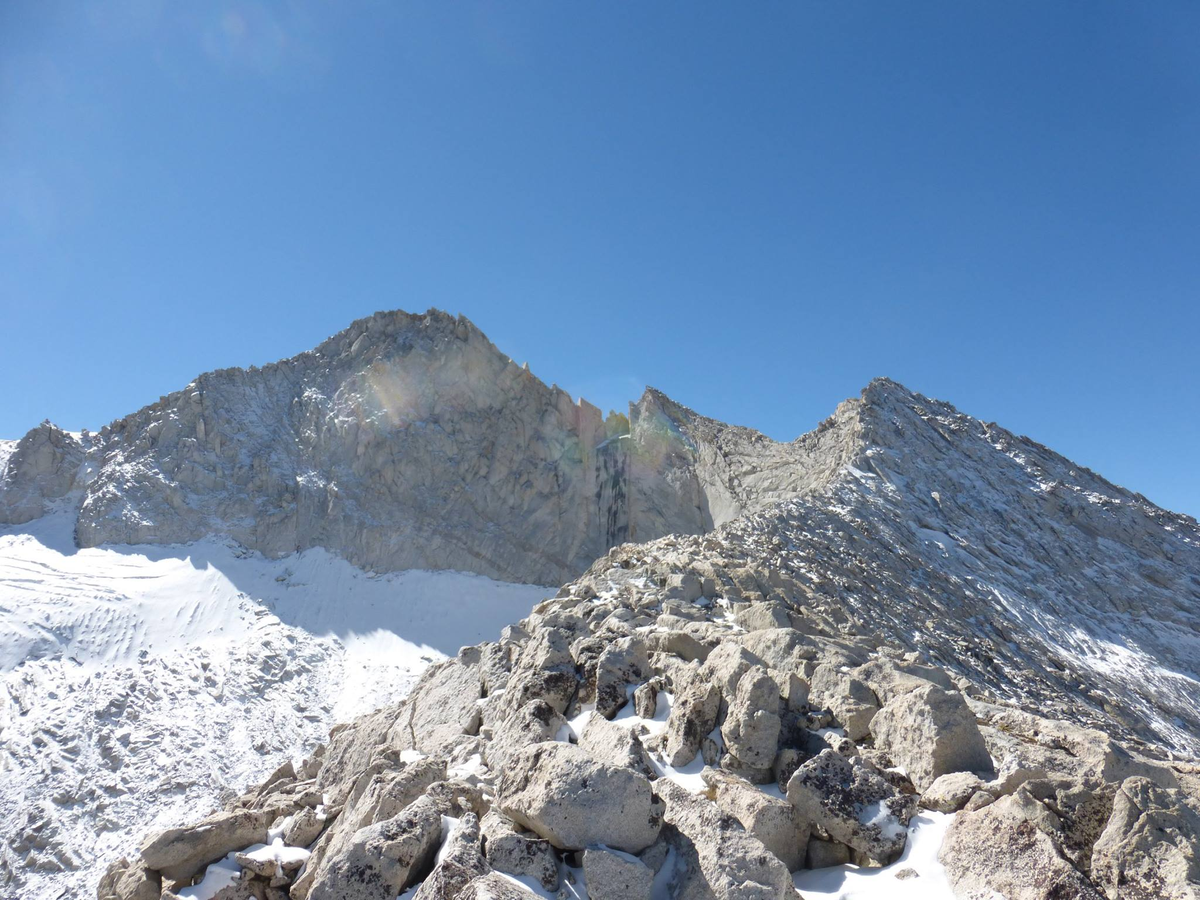

Slide 3
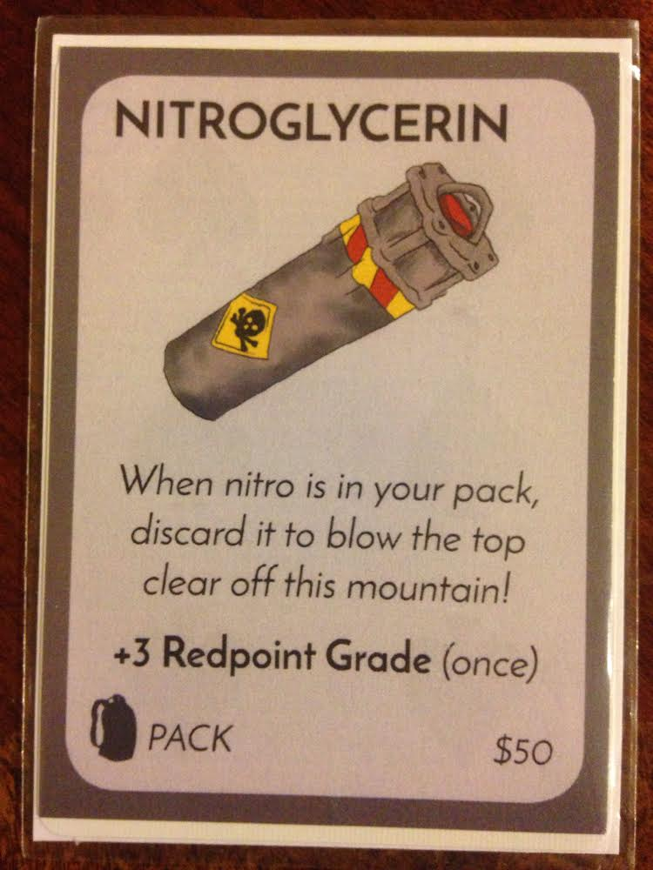
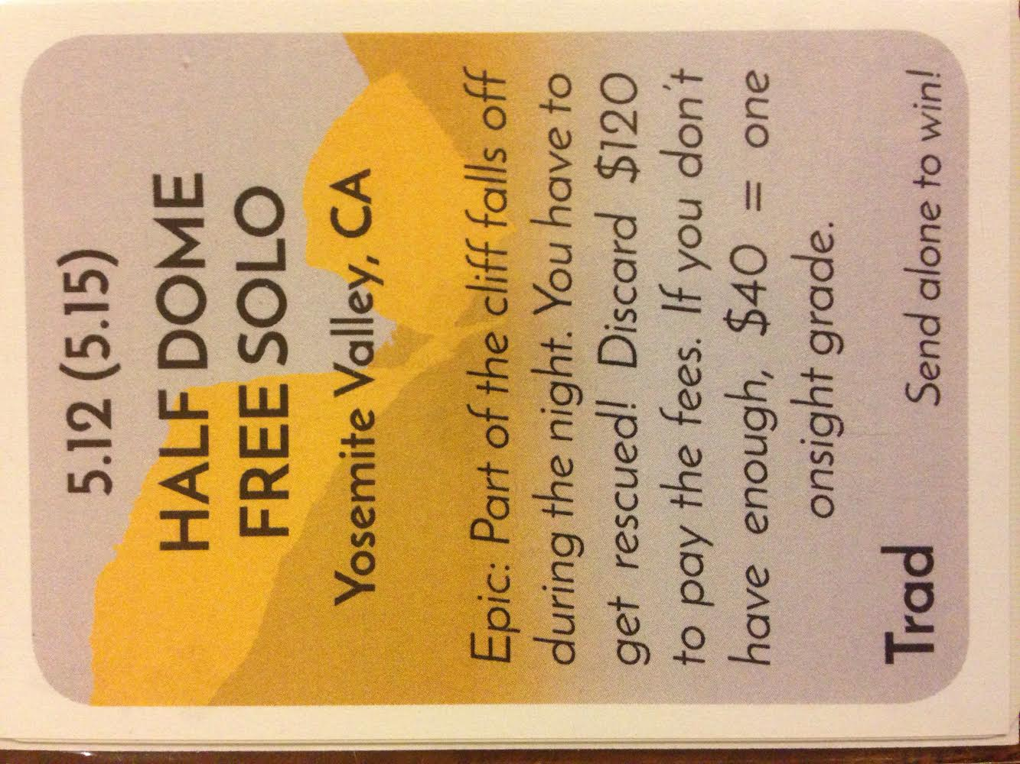
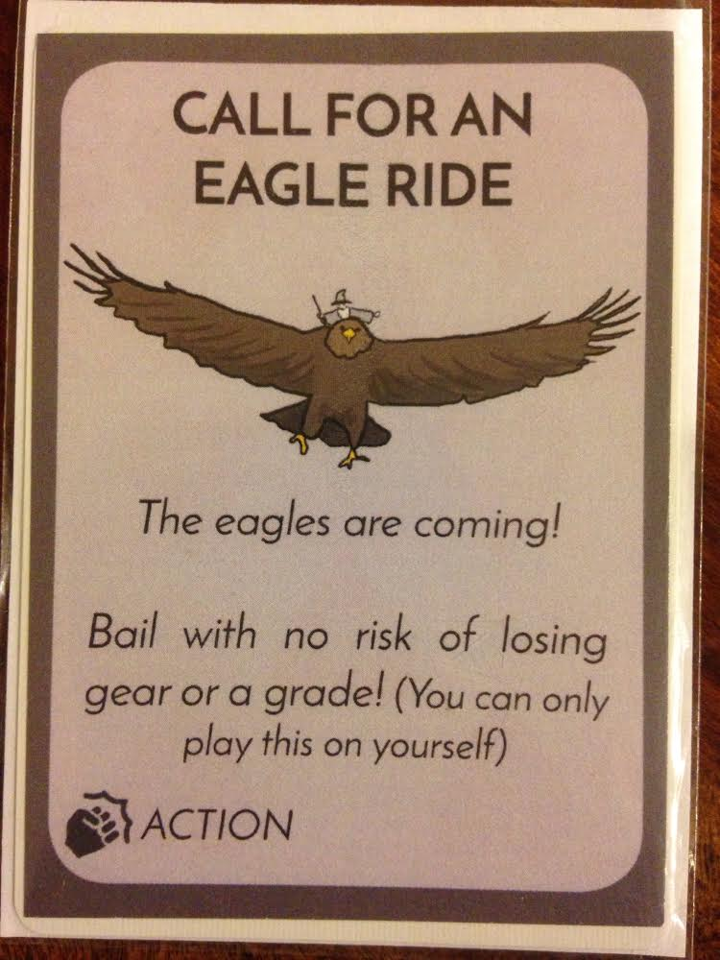
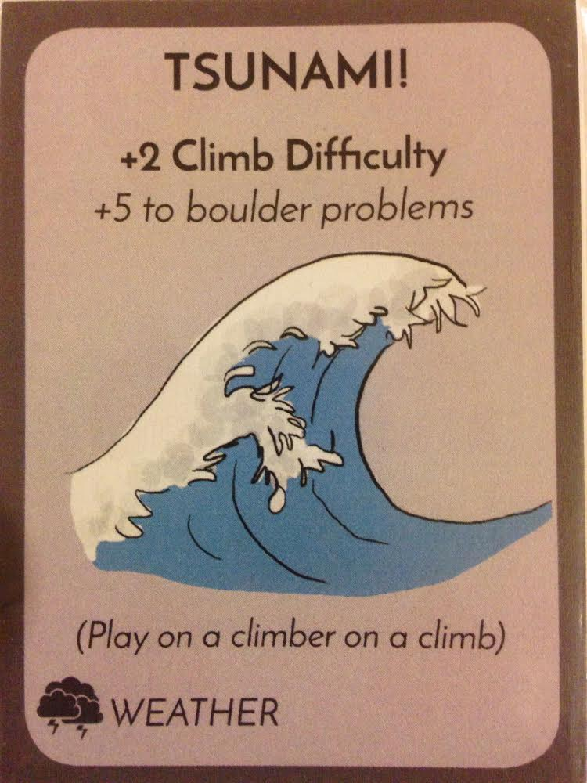
five15game.com

Slide 4
Dan Birman
2016-02-16
Frisem

Slide 5
Studying cognitive functions in humans
Dan Birman
2016-02-16
Frisem

Slide 6
Studying cognitive functions in humans,
what can we gain from model systems?
Dan Birman
2016-02-16
Frisem

Slide 7
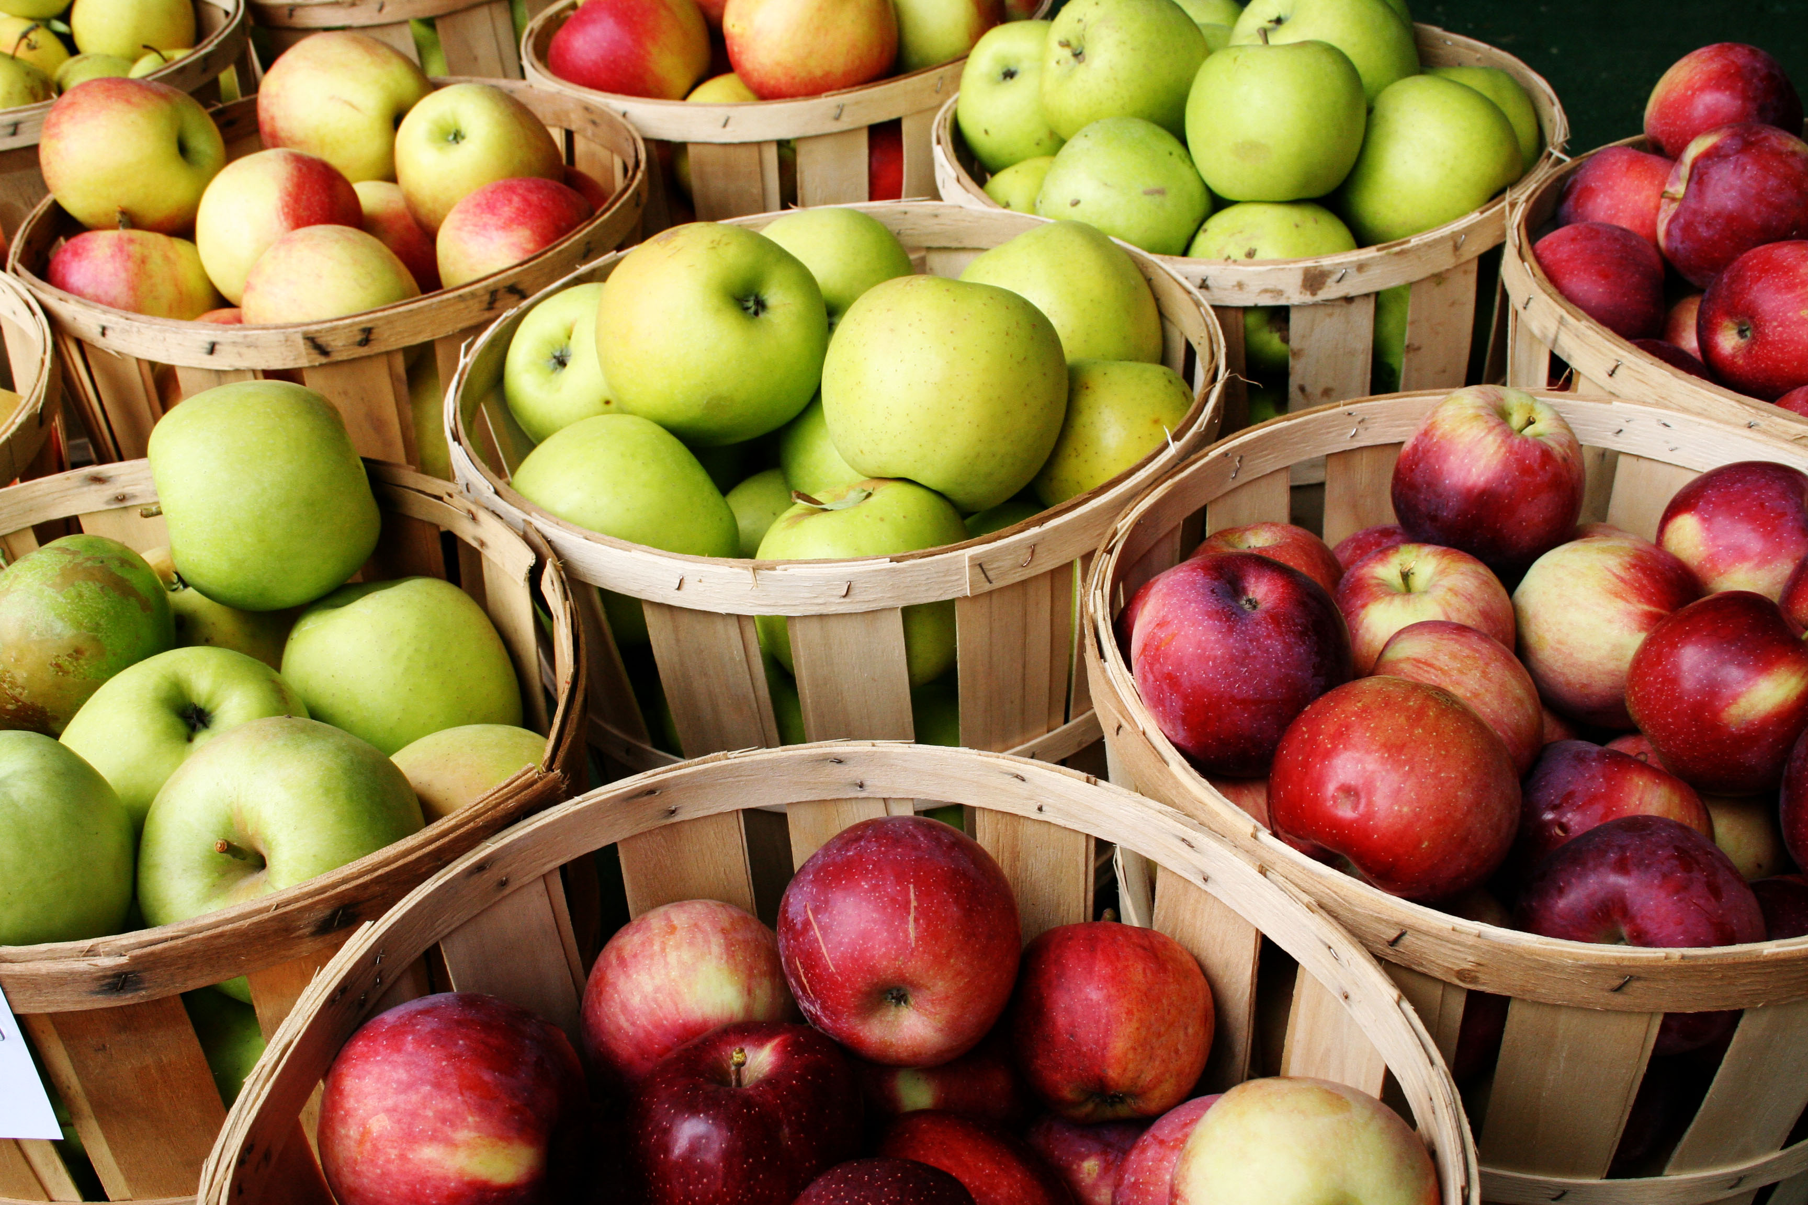

Slide 9
Size

Slide 10
Color
Size

Slide 11
Color
Taste
Size

Slide 12
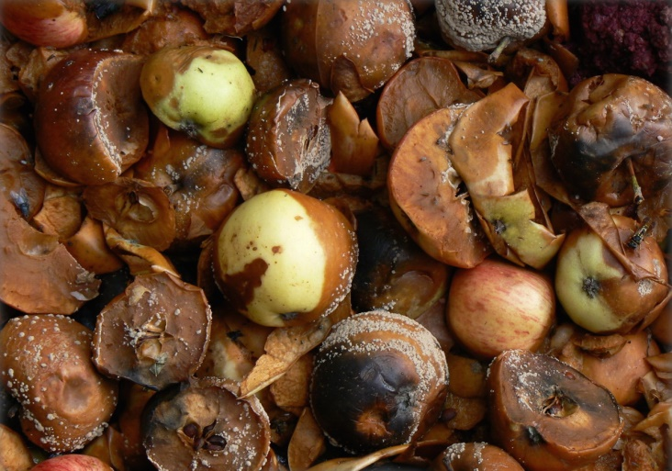
Rotten
Color
Healthy
Taste
Size

Slide 13
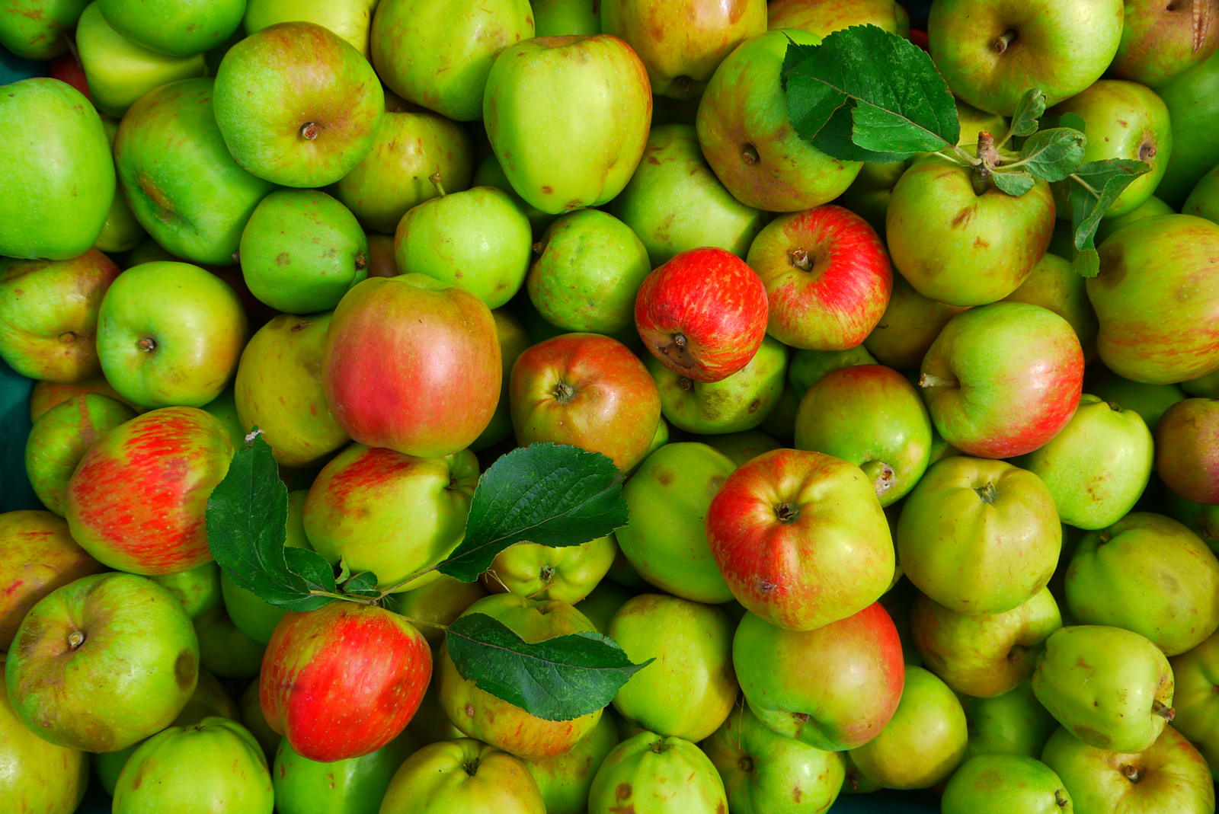
Notes:
Operationalized version of task!!

Slide 14
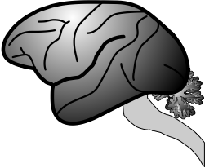
Notes:
Operationalized version of task!!

Slide 15
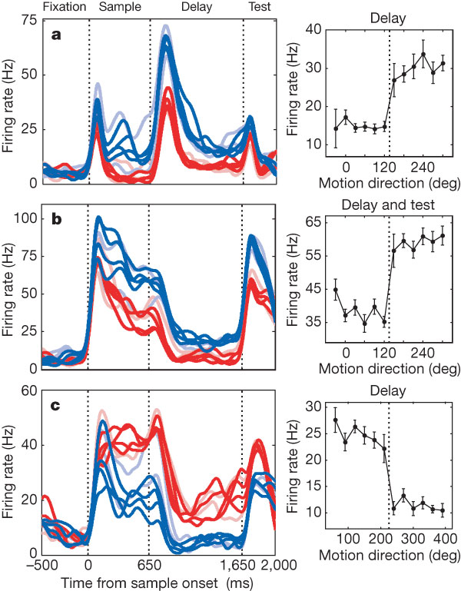
During categorization tasks
specific brain areas represent categories
Freedman, D. J., & Assad, J. A. (2006). Nature.

Slide 16
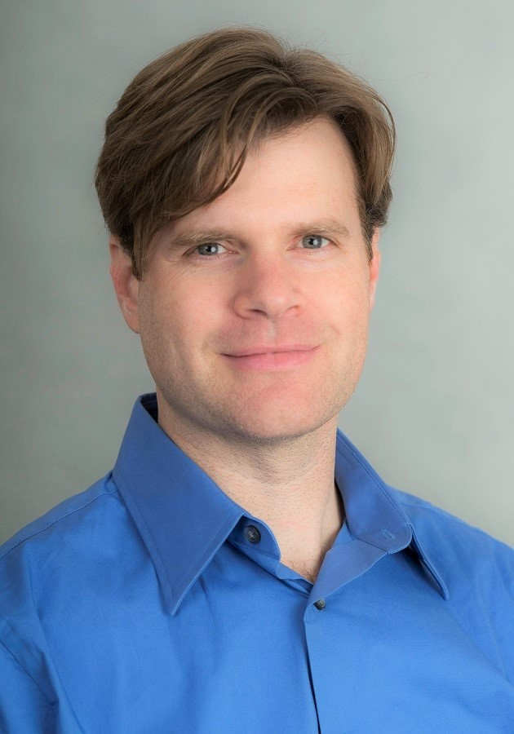
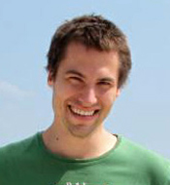
Nick Masse
David Freedman
During categorization tasks
specific brain areas represent categories
Freedman, D. J., & Assad, J. A. (2006). Nature.

Slide 17

Operationalizing Categorization
Rotten
Color
Healthy
Taste
Size

Slide 18
Operationalizing Categorization
What is it like to be a monkey doing categorization?
Rotten
Color
Healthy
Taste
Size

Slide 19

Are we operationalizing correctly?

Slide 20
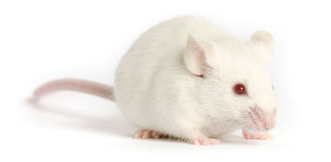
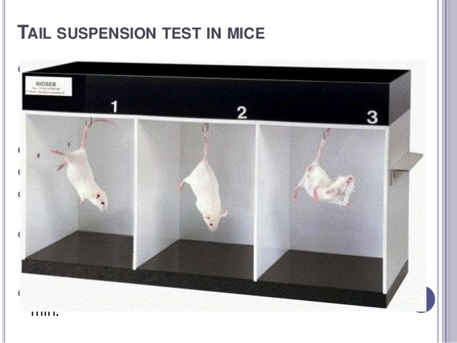
Are we operationalizing correctly?

Slide 21

Are we operationalizing correctly?

Slide 22
How do you train a monkey to do categorization?

Slide 23
How do you train a monkey to do categorization?
fixate…

Slide 25
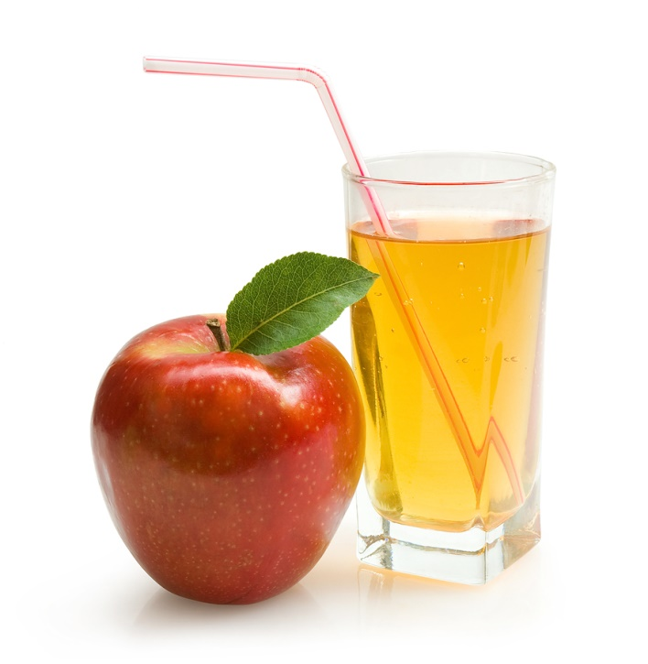

Slide 26
Operant Conditioning

Slide 27
How do you train a monkey?
Fixate to get juice…

Slide 28
How do you train a monkey?
Fixate to get juice…
Fixate + Bar release to get juice…

Slide 29
How do you train a monkey?
Fixate to get juice…
Fixate + Bar release to get juice…
Fixation + Motion stimulus +
Bar release to get juice…

Slide 30
How do you train a monkey?
Fixate to get juice…
Fixate + Bar release to get juice…
Fixation + Motion stimulus +
Bar release to get juice…
Fixate + Specific Stimulus + Bar release
to get juice…

Slide 31
Being monkeys…

Slide 32

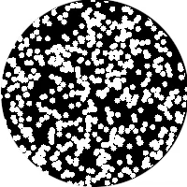
Sample Direction

Slide 33

Sample Direction

Slide 34

Sample Direction
Delay

Slide 35

Sample Direction
Delay
Test Direction

Slide 36
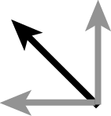
Sample Direction
Match to Sample Rule
Delay
Test Direction

Slide 37
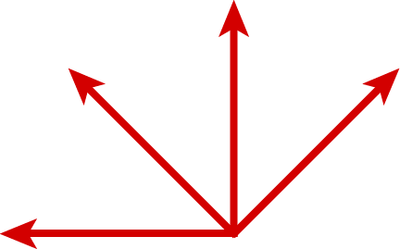
Category 1

Slide 38
Category 1

Slide 39
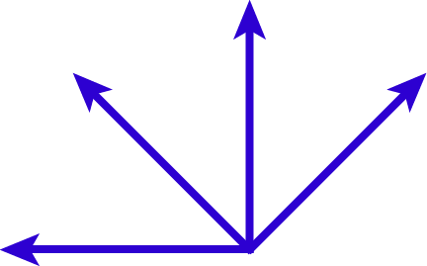
Category 1
Match to Category Rule
Category 2

Slide 40
Humans

Slide 41
Humans
Trivial

Slide 42
Humans
Trivial
Hard

Slide 43
Humans
Monkeys
Trivial
Hard

Slide 57
Small Angle
Difference:
Same

Slide 58
Large Angle
Difference:
Different
Small Angle
Difference:
Same

Slide 59
Large Angle
Difference:
Different
Small Angle
Difference:
Same

Slide 60
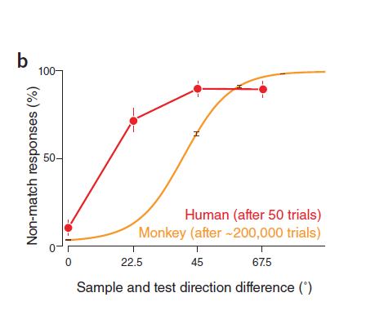

Slide 61
% of “Different” Choices

Slide 62
Mturk Data: N=45 DMS, 64 DMC
Birman, Gardner, Nat Neuro (2016).
% of “Different” Choices

Slide 63
Human
% of “Different” Choices

Slide 64
Human
% of “Different” Choices

Slide 65
Human
% of “Different” Choices
This is weird!

Slide 66
Human (after 50 trials)
% of “Different” Choices

Slide 67
Large Angle
Difference:
Different
Small Angle
Difference:
Same

Slide 68
Large Angle
Difference:
Different
Small Angle
Difference:
Same

Slide 69
Threshold:
Uncertain: 50% same / 50% different
Large Angle
Difference:
Different
Small Angle
Difference:
Same

Slide 70
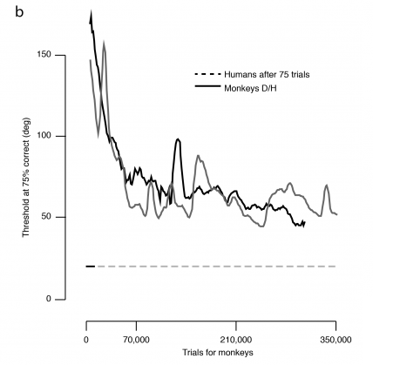
Human Performance (75 trials)

Slide 71
Threshold
(Switch from Same to Different)
Human Performance (75 trials)

Slide 72
Threshold
(Switch from Same to Different)
Human Performance (75 trials)

Slide 73
Threshold
(Switch from Same to Different)
Human Performance (75 trials)

Slide 74
This is really weird
Threshold
(Switch from Same to Different)
Human Performance (75 trials)

Slide 75
Humans
Monkeys
Trivial
Hard

Slide 76
Humans
Monkeys
Trivial
Very Hard
Hard

Slide 80
Sample

Slide 81
Test
Sample

Slide 82
Test
Sample

Slide 84
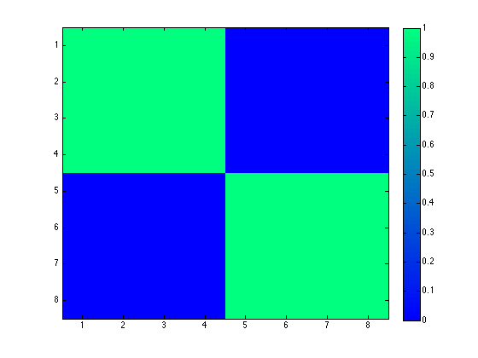
Proportion of
Same Choices

Slide 85

Proportion of
Same Choices

Slide 86
Human Data
210 Trials, n=48
Sped up to ~30 trials / sec

Slide 87

Human Data
Proportion of
Same Choices

Slide 88

Monkey Data
Proportion of
Same Choices

Slide 89

Monkey Data
Proportion of
Same Choices

Slide 90
Monkey Data
Proportion of
Same Choices

Slide 91
Monkey Data
12,500 Trials, n=2
Sped up to ~1000 trials / sec

Slide 92

Monkey Data
Proportion of
Same Choices
12,500 Trials, n=2

Slide 93
Humans
Monkeys
Trivial
Very Hard
Hard

Slide 94
Humans
Monkeys
Trivial
Very Hard
Hard
Hard

Slide 95
Humans
Monkeys
Trivial
Very Hard
~10 Trials
~100,000 Trials
Hard
Hard
~1,000 Trials
~10,000 Trials

Slide 97
Did we operationalize categorization correctly?

Slide 98
Did we operationalize categorization correctly?

Slide 99
Did we operationalize categorization correctly?

Slide 101
What features are the monkeys using
and how are they using them?

Slide 102
What features are the monkeys using
and how are they using them?
Can monkeys even learn this feature
of sameness?

Slide 103
Are we operationalizing correctly?

Slide 104


Thank you!
Justin Gardner
Freedman Lab @ U Chicago
Nick Masse
Gardner Lab @ Stanford
David Freedman

Slide 105
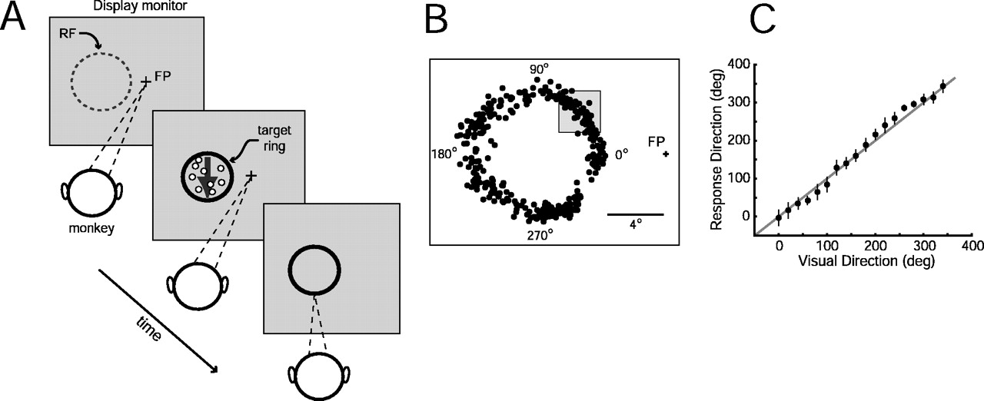
M. James Nichols, and William T. Newsome J. Neurosci. 2002;22:9530-9540

